Slide 1


User Interface
Prototype

Slide 2
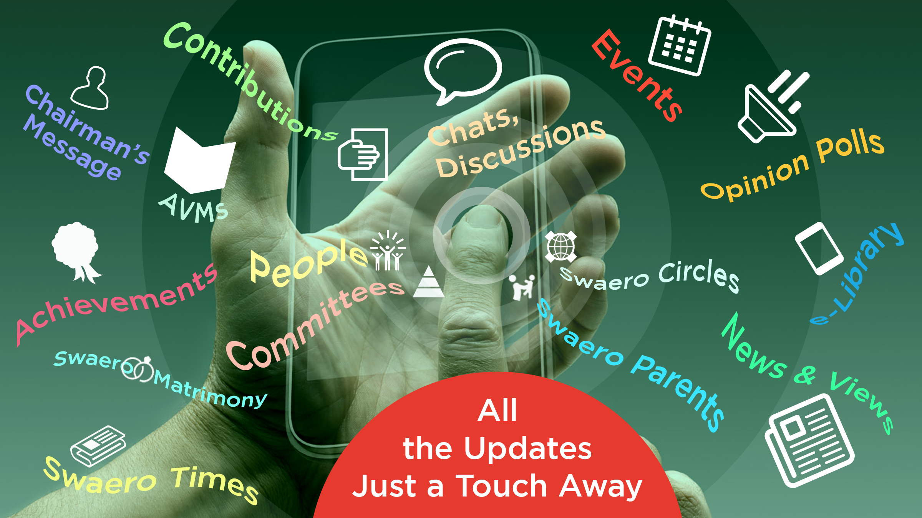
User Interface
Prototype

Slide 3

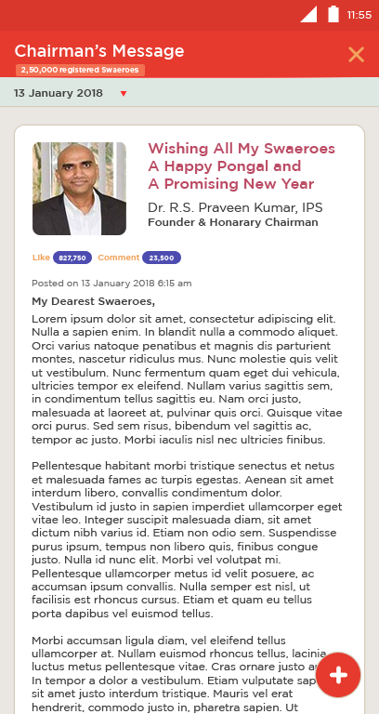
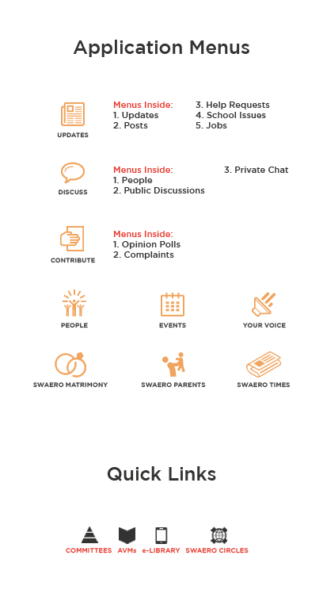
Chairman Message for All Users
All Users could be welcomed with Chairman’s Message. Once message closed, they can be taken to the Updates (next slide)
Number of users registered to the app could be displayed on every slide under screen titles.
Quick links will have Committees, AVMs, e-Library and Swaero Circles and prominently placed alongside of the titles.

Slide 4
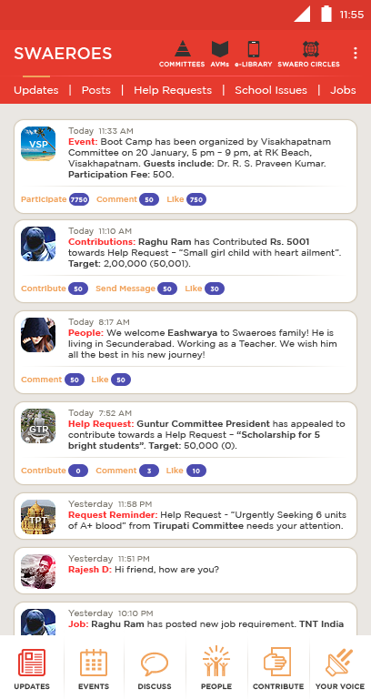
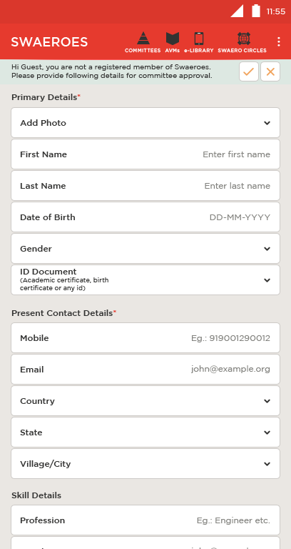
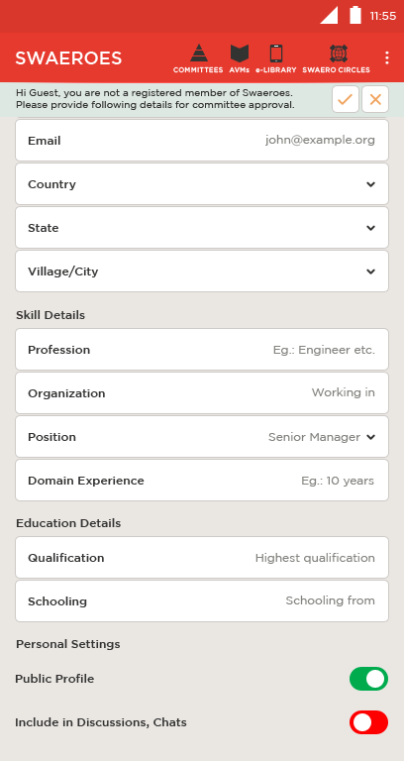
Landing Page for Registered & Unregistered members
Registered Users will be welcomed with Updates from News, Events, Help Requests, New People etc.
Unregistered Users will have to submit online registration request. The App’s features are not accessible until the verification.

Slide 5
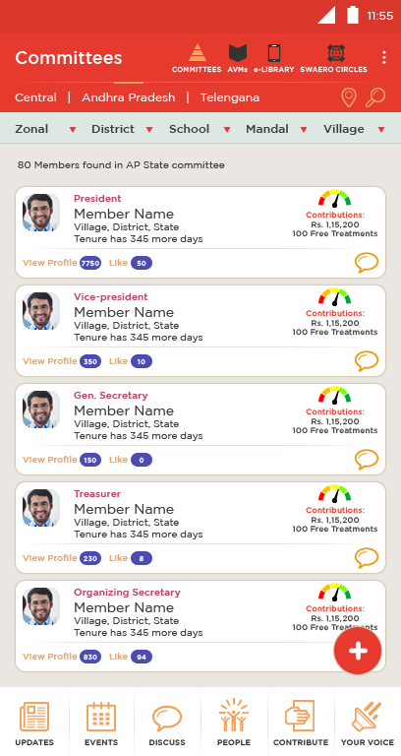
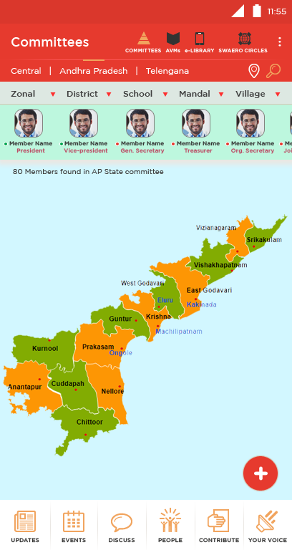
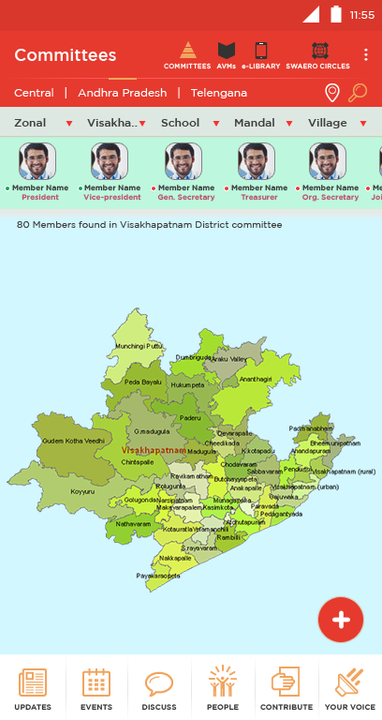
Committees
Committees by State, Zonal, District, School, Mandal and Village levels.
Committees can be seen both in Map view and List View

Slide 6
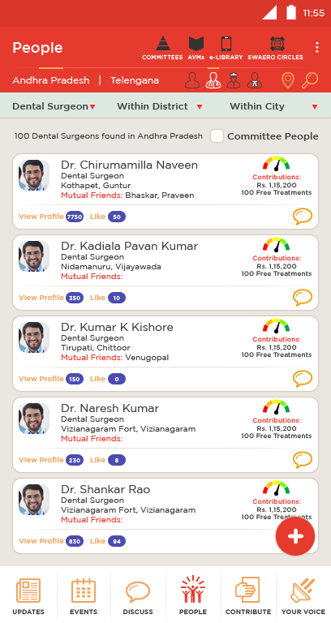
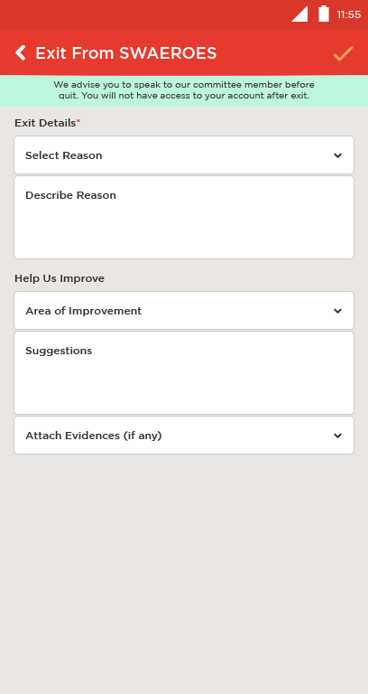
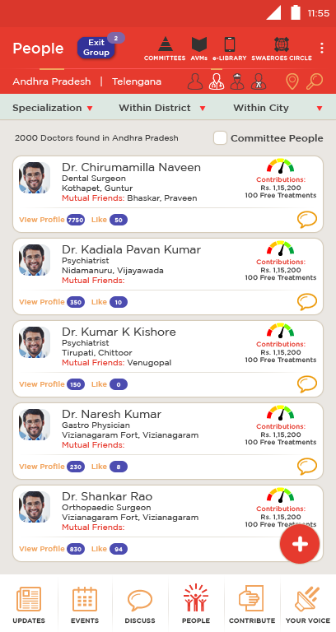
People of SWAEROES
All the people who are part of SWAEROES family can be found in ‘People’ menu.
Exit Group will have list of the people who left the organization. Exit Group link shall be visible only to the App Admins.
User who would like to Exit from the organization will be able to raise his concerns and suggestions.
People can be searched using various parameters like, profession, skills, school, organization etc.

Slide 7
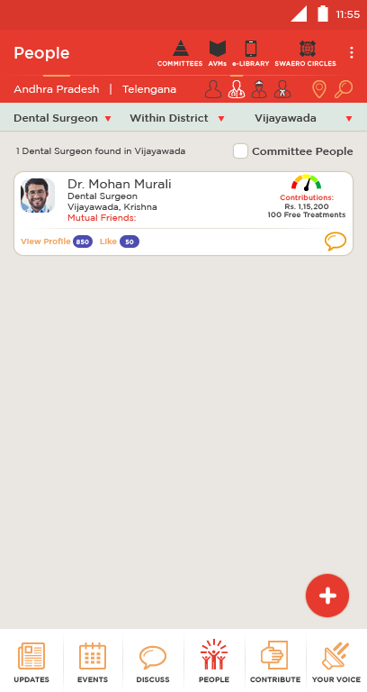
People of SWAEROES
All the people who are part of SWAEROES family can be found in ‘People’ menu.
In this example, the user has got this result when searched for Doctors specialized in Dental Surgery and also living in Vijayawada.
Filter the search results by, Specialization of the professional and, present living District and City
Quick links to find professionals: Doctors, Policemen and Lawyers
Find only people who are part of Organization committee.

Slide 8
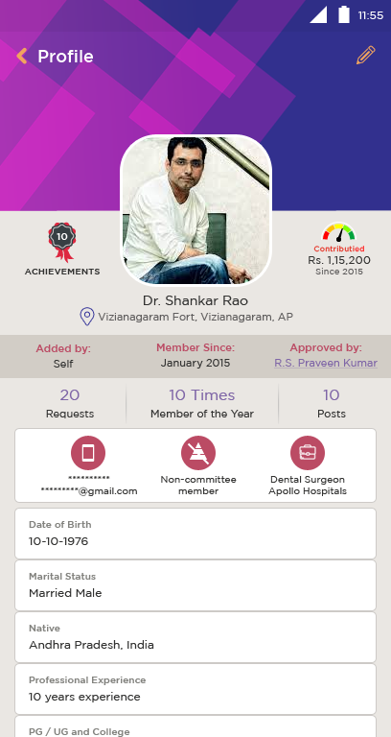
People & Their Profiles
Sample image for detailed profile of a member.
Tap on View Profile to view.
Mobile and eMail could be hidden and accessible only to the admins or visible on request

Slide 9
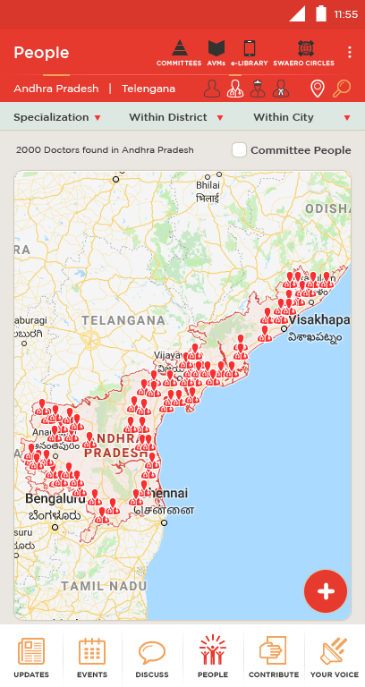
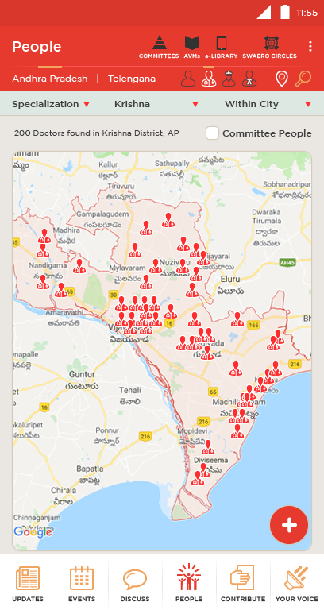
People of SWAEROES in Maps
User can easily toggle between List View and Map View

Slide 10
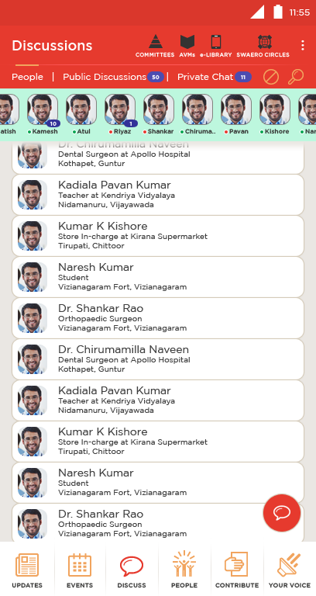
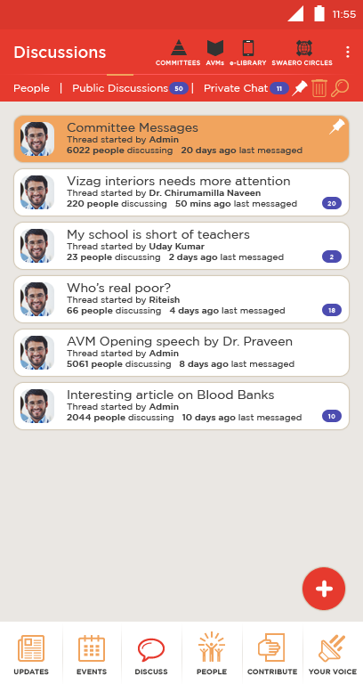
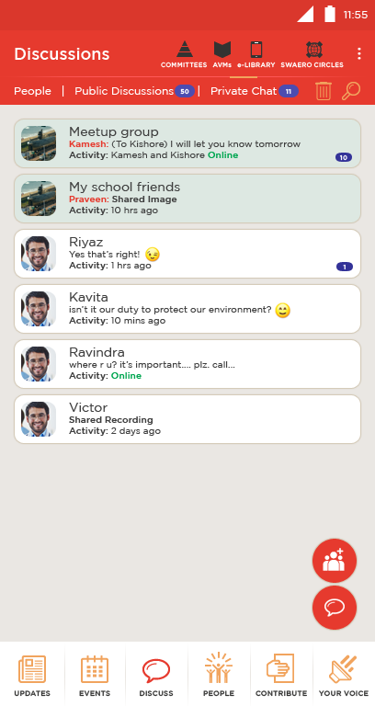
Types of Discussions
Discussions will have two categories: Public and Private.
A message can be send without being part of discussion by selecting people from the list.
Public Discussions can be participated and discussed by any user having rights.
In Private Chat, people who are added to a group alone can participate

Slide 11

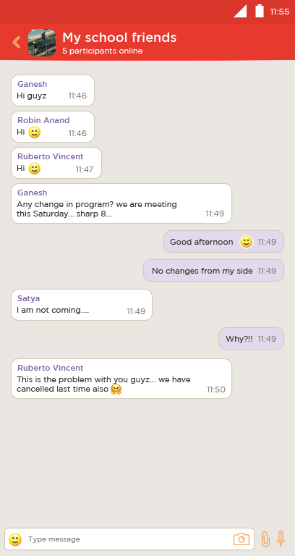
Private Discussions
On Discussions’ main page, you will be able to see the members who are participating in Chats.
Sample of an ongoing Private Group Chat.
Unread Notification
Present Status
Green: Online
Red: Offline

Slide 12
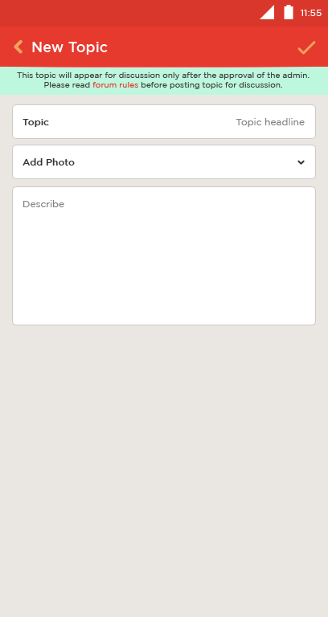
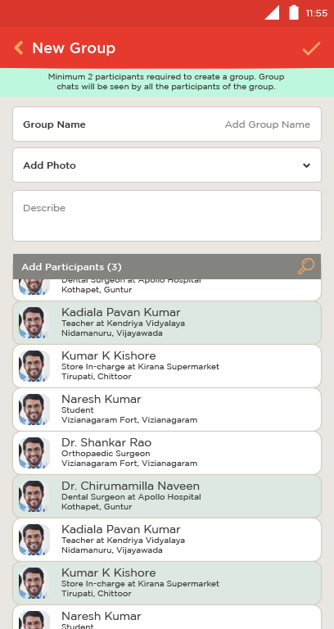
Adding Topics and Groups
Create New
Topic for public discussion.
Create New Group and add Participants for a Private Chat.

Slide 13
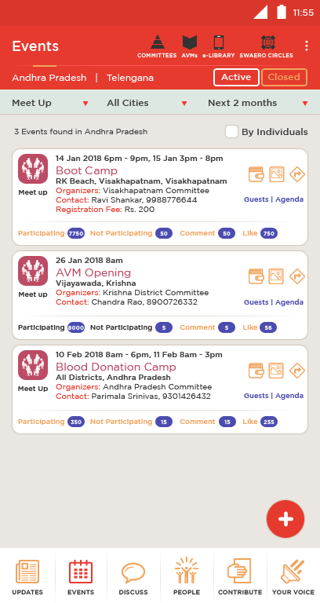
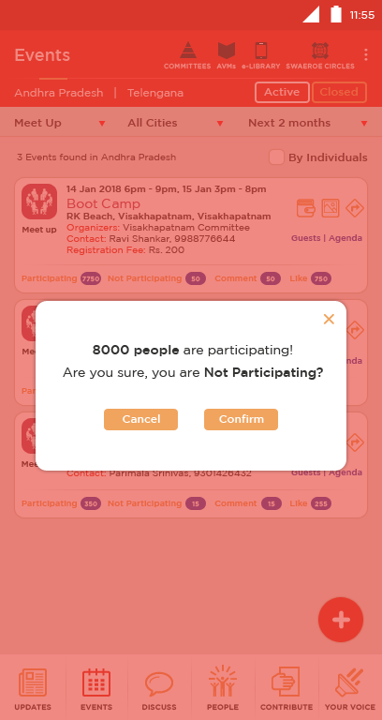
Active Events
Active Events that are organized in Andhra Pradesh
Participating, Not Participating links will be disabled from further access once user confirms whether he will Participate or Not Participate
For an Active Event:
User can contribute to the event expenses.
Ability to view images
Gets help with directions

Slide 14
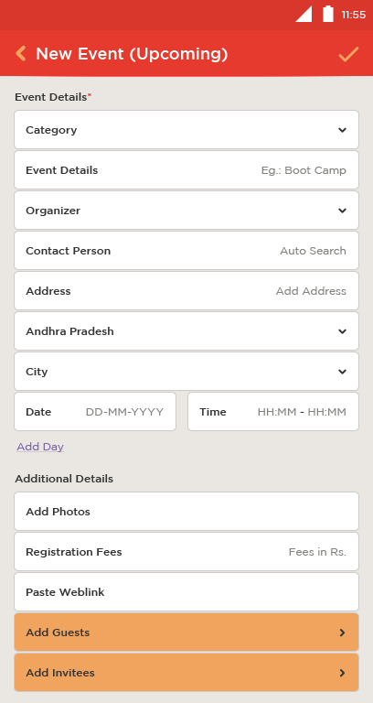
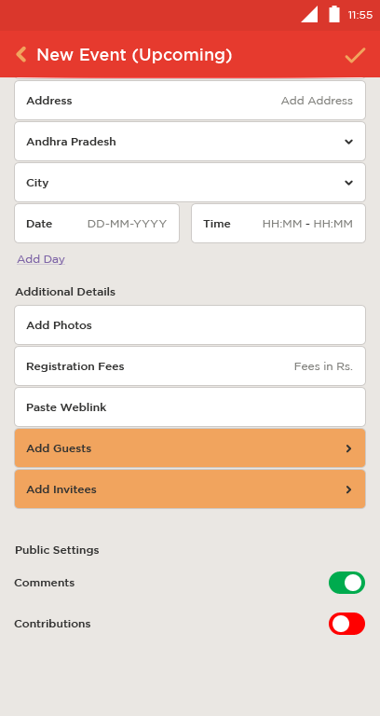
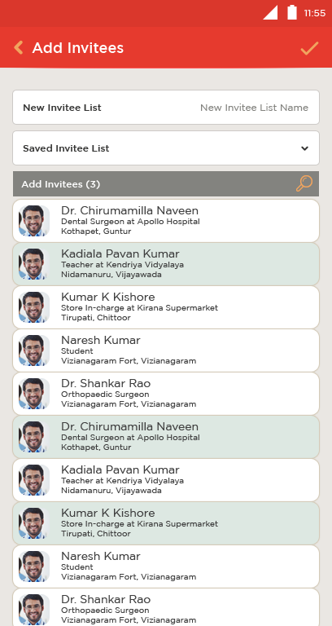
Creating New Event
Add new invitees from people.
The user can save the list of invitee for future use.
So, next time user has to choose from saved sets of invitees.

Slide 15
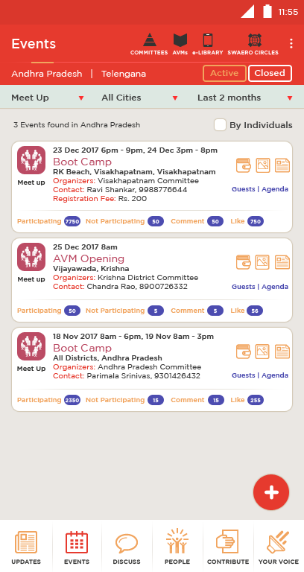
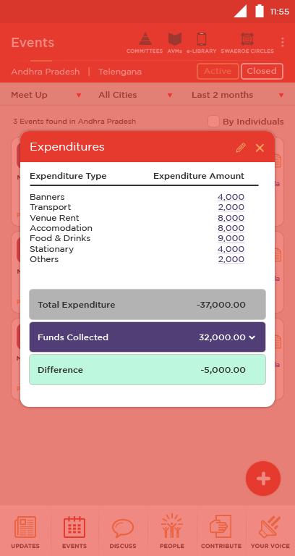
Successfully Completed Events
Closed Events that were completed successfully.
Admin can edit expenditure details.
Tap to get scanned bills related to the expense.

Slide 16
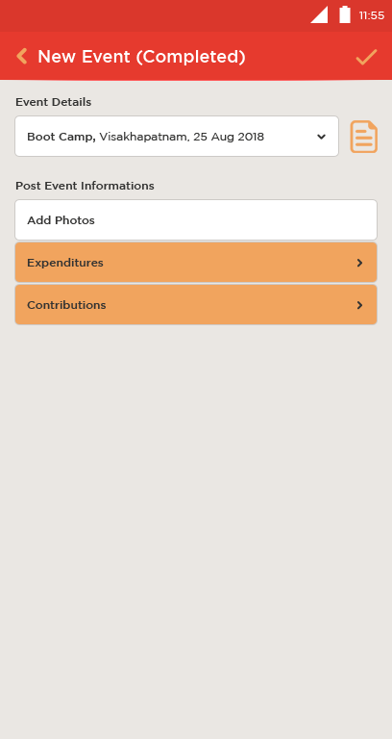
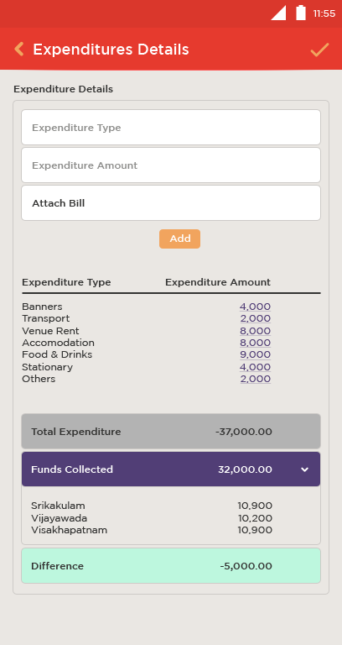
Successfully Completed Events
Select a completed event and update information like photos, videos, expenditure etc.
To view complete details of the event.

Slide 17
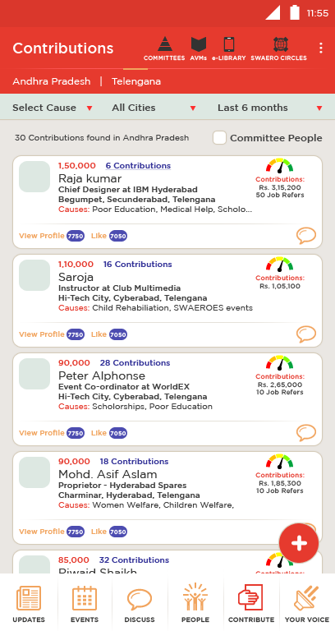
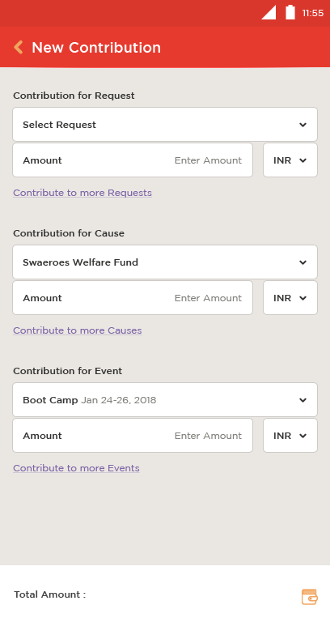
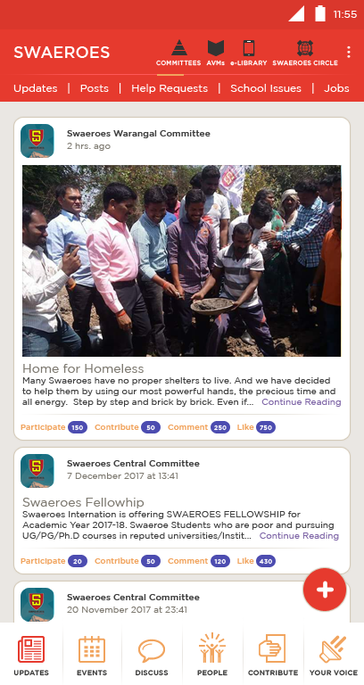
Contributions
List of Contributions can be accessed based on State, Cause, Cities and for Particular Period.
Multiple contributions shall be possible.
Contribution Meter.
Contribute for a help request.

Slide 18
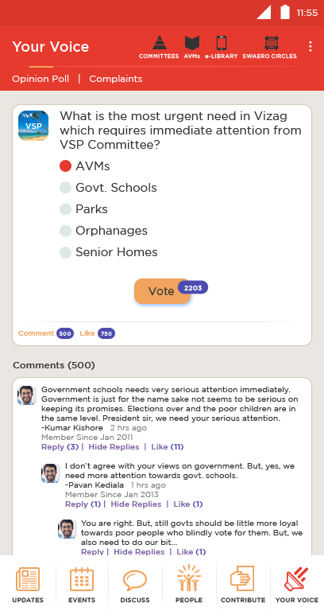
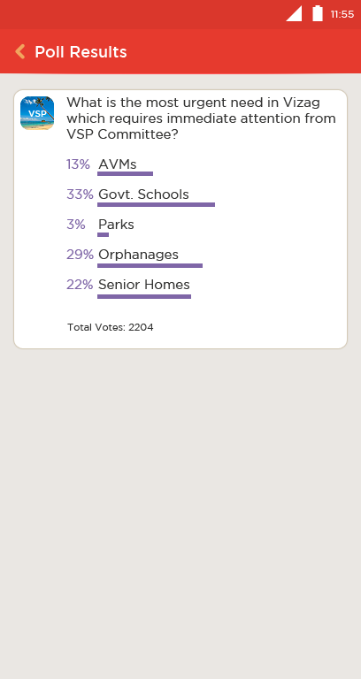
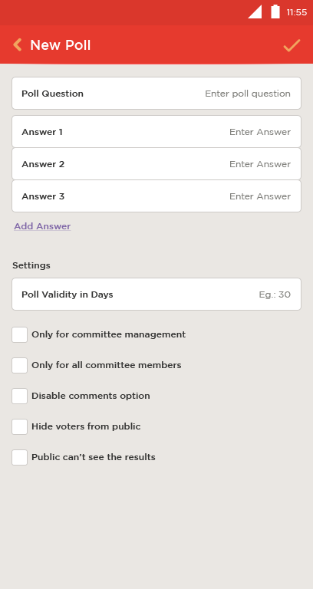
Opinion Poll
Opinion Polls will seek user opinion on variety of issues. User can Vote and Like the poll issue. User can also write their opinions regarding the poll in comments.
Sample of Poll Results and New Poll setup

Slide 19

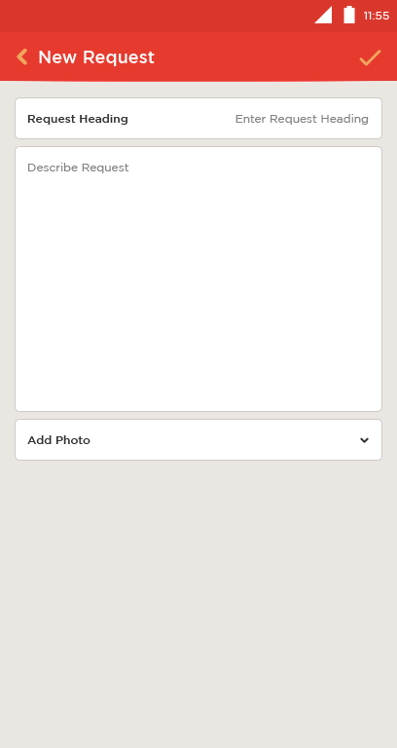
Help Requests
Approved Help Requests will be visible to public.
Anybody can create request, but it appears to public only on Admin approval. (next slide)

Slide 20
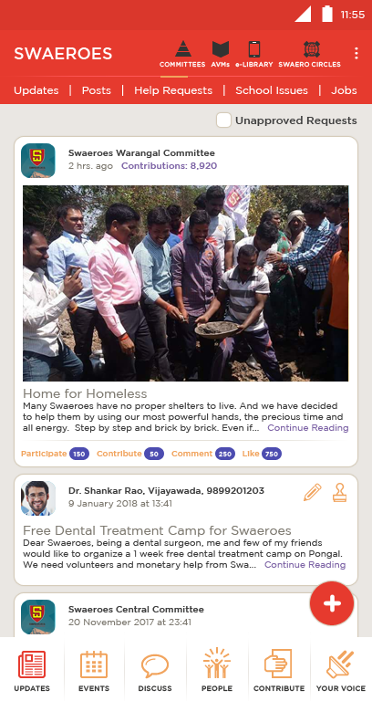
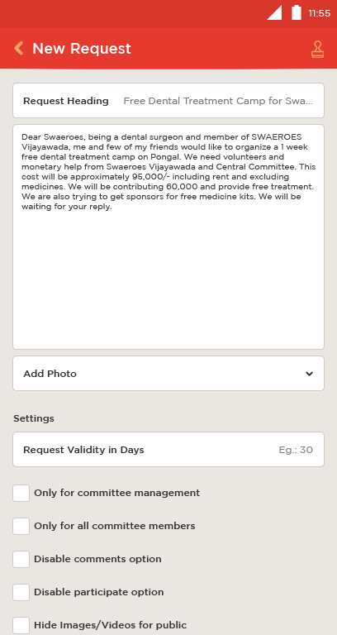
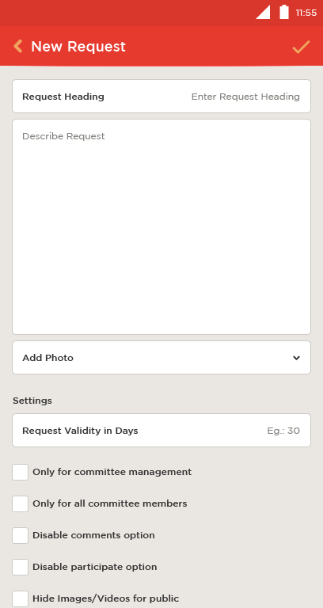
Help Requests
Pending Help Requests can be edited and approved only by the admin.
Settings are visible to the admin alone.
Admin can choose to see only unapproved requests. This option is visible only to the admin.
The Help Request is waiting for approval.

Slide 21
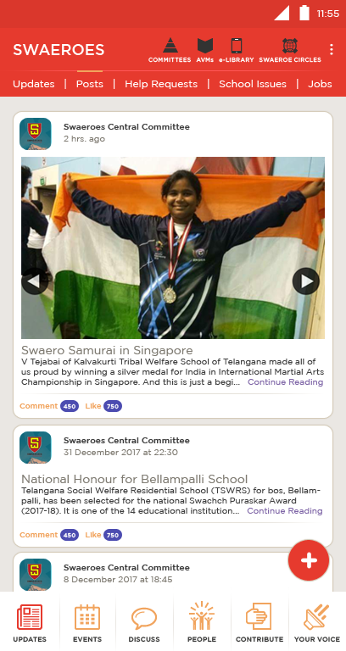
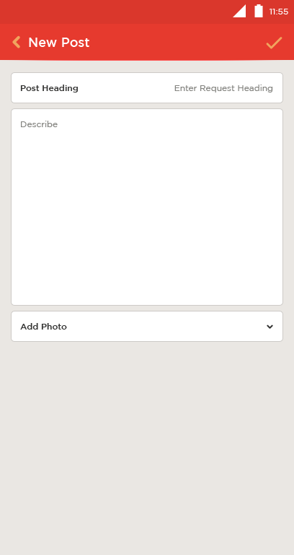
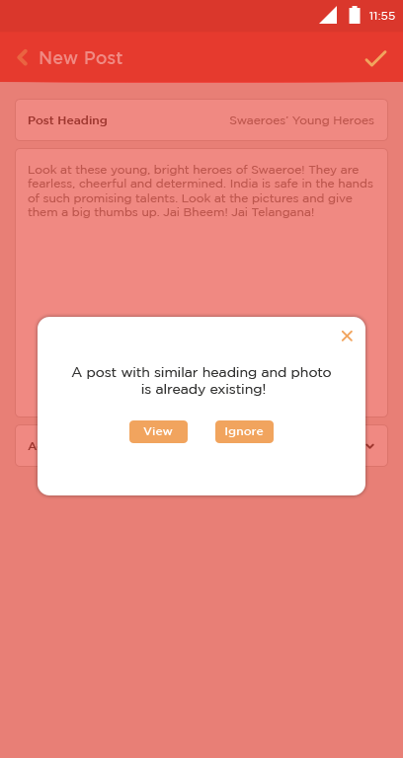
Achievements, Posts and News
Approved Posts will be visible to public.
New post can be created by any user but will be made public after editing and approval of admin.
User will be saved from duplication of posts , images or videos. The app will inform when it finds if similar content is already existing.

Slide 22
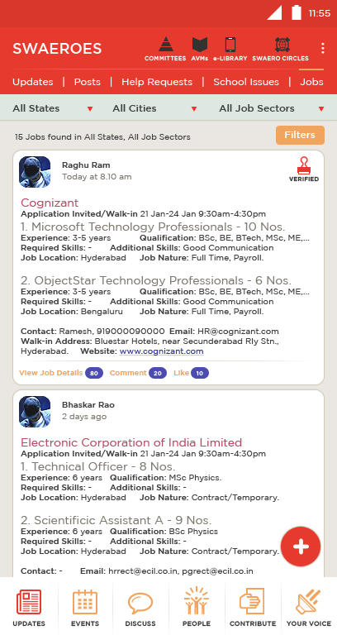
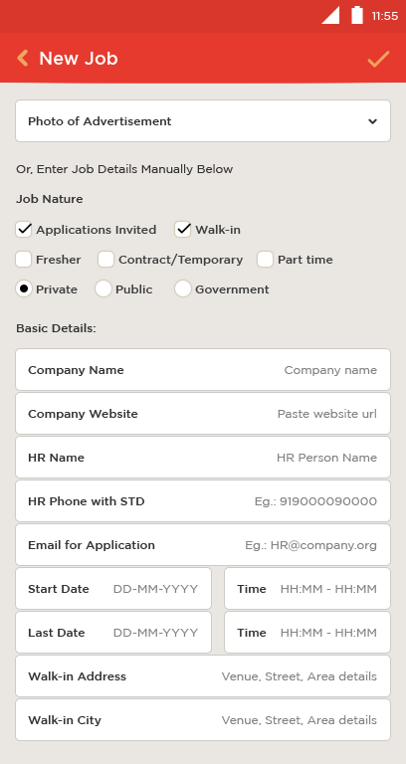
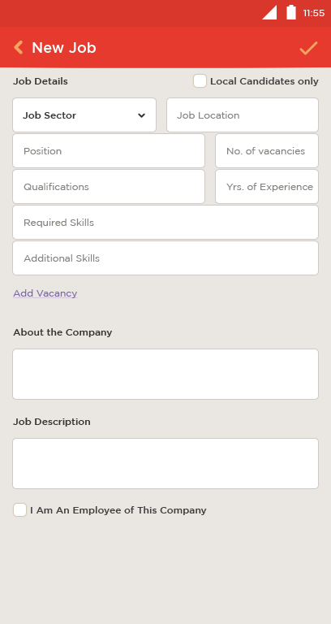
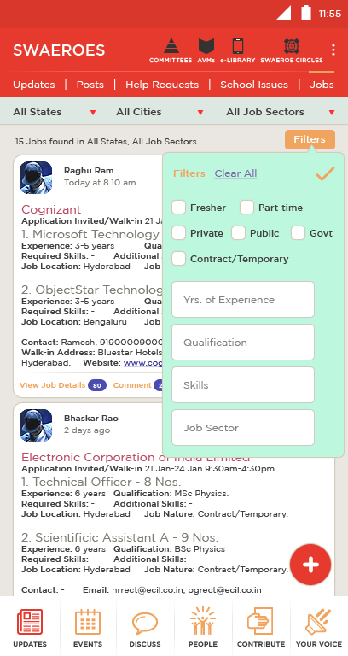
Jobs
This job has been verified.
Incase, there are multiple vacancies in the same company
Filtering jobs will make search easy.

Slide 23
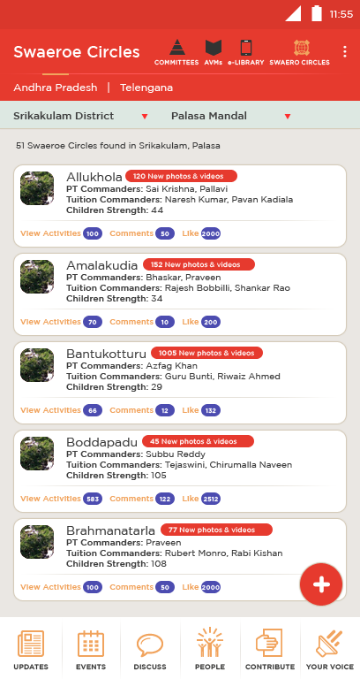
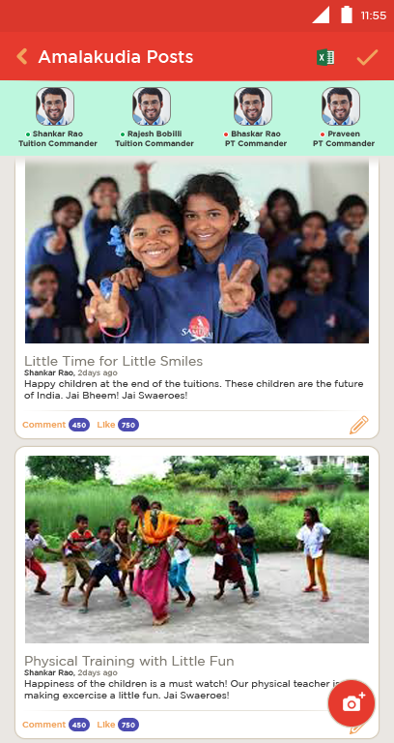


Swaeroe Circles
All updates related to Swaeroe Circles will be available here.
Details like children name, attendance etc. can be uploaded or downloaded.

Slide 24


AVMs and e-Library
For knowledge seekers, it will be easy to find nearest AVM.
Or, user can use e-Library as per convenience. And members can add e-books, documents, audios and videos to the digital collection for the benefit of all.

